Slide 1
Beyond Chunk Size
IDEA PRESENTATION · MINI PROJECT REVIEW 1
A multi-domain study of chunking, embedding and retrieval strategies for RAG
Team 2: Vinayak Kalal · Samvit Nandakishore · Sabbir Mondal · Rahul Shenoy
Prompt Engineering and Optimization for Generative AI (UE24AM343AB5)

Slide 2
Retrieval quality decides RAG quality
WHY THIS MATTERS
1
2
3
The problem
The gap
Our angle
A RAG answer is only as good as the text it retrieves. Chunk size, splitting method and embedding model change recall, noise and cost, yet they are often chosen by habit.
In the studies we reviewed, comparisons use one generic corpus and one retrieval setup. Few test how document type, embedder and reranker interact, or what compression costs.
Compare chunking × embedding × retrieval with chunk-size-independent metrics, then turn the results into a decision matrix and advisor app.

Slide 3
LITERATURE SURVEY (1 of 2)
Theme | Work | What it contributes
Foundations | Lewis et al. [1] | Generator plus retrieval memory; basis of our pipeline
Foundations | Gao et al. [3] | Naive, advanced and modular RAG; frames our pipeline
Foundations | Barnett et al. [4] | Seven failure points, several in retrieval
Chunking | Qu et al. [7] | Semantic chunking gains not consistent enough for its cost
Chunking | Chen et al. [8] | Proposition units can improve retrieval and QA
Chunking | Yepes et al. [9] | Structure-aware chunking helped on financial reports
Chunking | Finardi et al. [10] | Retriever, chunk and generator choices interact
Chunking | Günther et al. [11] | Late chunking: embed long text first, then pool chunks
Chunking | Anthropic [12] | Contextual Retrieval: prepend LLM-written context
Embeddings | Reimers and Gurevych [13] | Sentence-BERT: bi-encoder sentence embeddings

Slide 4
LITERATURE SURVEY (2 of 2)
Theme | Work | What it contributes
Embeddings | Wang et al. [14] | E5: weakly-supervised contrastive pre-training
Embeddings | Xiao et al. [15] | BGE: open general-purpose embedding family
Embeddings | Kusupati et al. [20] | Matryoshka: leading dimensions stay useful when truncated
Embeddings | Shakir et al. [21] | Binary and scalar quantization keep much of the quality
Pipeline | Robertson and Zaragoza [22] | BM25: strong sparse baseline for exact terms
Pipeline | Cormack et al. [23] | Reciprocal Rank Fusion: training-free rank merging
Pipeline | Nogueira and Cho [24] | Cross-encoder reranking improves ordering
Pipeline | Wang et al. [25] | Recommends balanced RAG component combinations
Evaluation | Es et al. [27] | RAGAS: reference-free RAG metrics with an LLM judge
Evaluation | Zheng et al. [28] | LLM judges agree with humans but show known biases

Slide 5
What is still missing
RESEARCH GAP
1
Limited document diversity. Most studies use one generic or single-domain corpus.
2
Components studied in isolation. Chunking, embedder and reranker are rarely varied together.
3
Metrics tied to chunk boundaries. Chunkers of different sizes are hard to compare fairly.
4
Efficiency studied separately. Truncation and quantization are seldom combined with chunking.
5
No practitioner-ready output. Few decision aids map document type and priorities to a setup.

Slide 6
Three hypotheses
WHAT WE EXPECT
H1
H2
H3
Structure beats size
Reranking narrows the gap
Compression is cheap
Structure-aware chunking beats fixed-size and semantic chunking on structured documents such as API docs and legal text.
Truncated or binary embeddings lose little accuracy while cutting storage and latency.
A reranker narrows the performance gap between chunking strategies.
Chunking
Retrieval pipeline
Efficiency

Slide 7
A staged experiment
METHOD
1
2
3
4
Corpora
Chunking
Embeddings
Retrieval
→
→
→
API documentation and legal text, with a question set and evidence spans
Fixed, sentence, semantic, structure-aware and parent-child (hierarchical)
BGE, E5, GTE and MiniLM, with optional Gemini and OpenAI embeddings
Dense (FAISS), hybrid with BM25, and hybrid plus cross-encoder reranker
Staged runs keep the grid small: all chunkers first, then top chunkers × embedders, then retrieval variants, then efficiency tests.

Slide 8
Corpus and question set
DATA
8
70,791
85
documents (Python library docs)
words of text
questions with evidence spans
Question types
Why this corpus
Single-hop
60
Code blocks, tables and headings make it structured. A legal corpus will be the second document type.
Multi-hop
15
Unanswerable
10

Slide 9
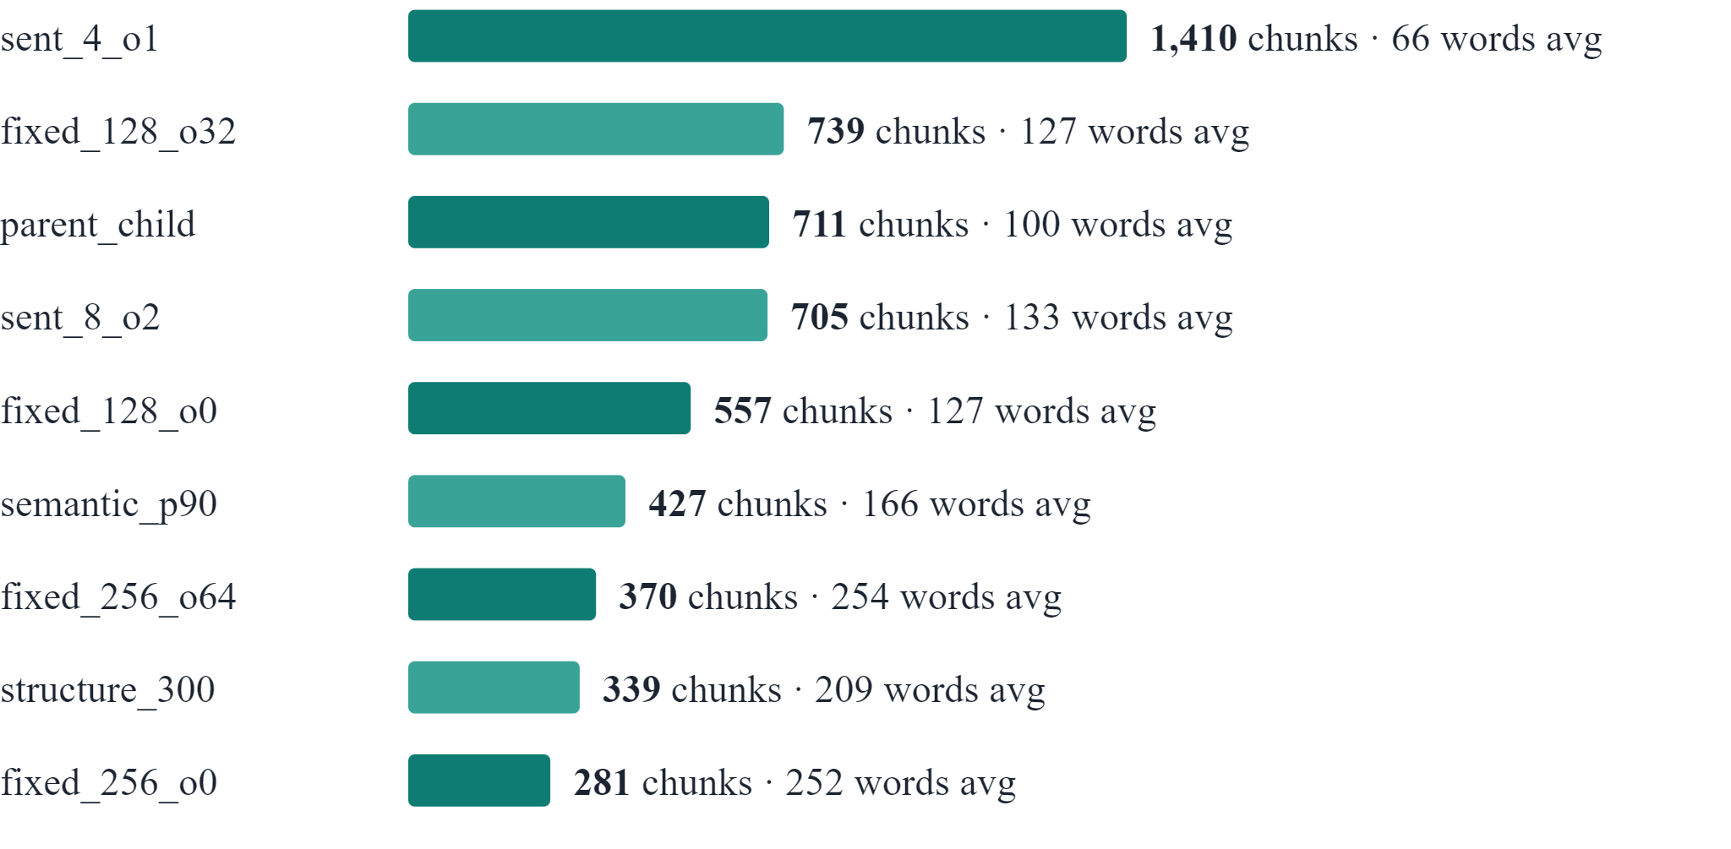
Chunking strategies prepared
CHUNKING
Same text, different chunk sets
●
Built from the same 70,791 words
●
281 to 1,410 chunks per strategy
●
Average length 66 to 254 words
●
parent_child embeds small chunks and returns the larger parent

Slide 10
Models and retrieval modes
MODELS AND RETRIEVAL
Model | Hugging Face id | Dimensions | Notes
bge-small | BAAI/bge-small-en-v1.5 | 384 | Query instruction prefix
e5-small | intfloat/e5-small-v2 | 384 | Query and passage prefixes
gte-small | thenlper/gte-small | 384 | General text embeddings
MiniLM | all-MiniLM-L6-v2 | 384 | Also splits text for semantic chunking
1
2
3
Dense
Hybrid
Hybrid + rerank
FAISS vector search
BM25 + dense, merged by reciprocal rank fusion
Cross-encoder re-scores the top candidates

Slide 11
Testing each hypothesis
TEST PLAN
Hypothesis | Experiment | Evidence
H1 · structure-aware chunking wins | All chunkers across embedders, on each document type | Paired bootstrap on f_ctx with 95% CI
H2 · reranking narrows the gap | All chunkers × dense, hybrid and hybrid + rerank | Spread between best and worst chunker per mode
H3 · compression is cheap | 256, 128 and 64 dimensions, plus binary vectors | f_ctx relative to full vectors, index size, latency
Outputs: heatmaps, pipeline-effect charts, an accuracy-versus-latency view and the decision matrix.

Slide 12
Next steps and plan
NEXT STEPS
Idea, literature survey and groundwork
High-level design and data collection
Final demo and IEEE report
Before Review 2
Suggested team split
○
Human-verify the 85 gold questions
●
Data and chunking pipeline
○
Add a legal or regulatory corpus
●
Embeddings and efficiency
○
Re-run with confidence intervals
●
Evaluation set and metrics
○
Cross-check the judge with a second provider
●
Retrieval, reranking and advisor app
○
Demo the Config Advisor app

Slide 13
Thank you

